Slide 1
Apache Kafka

Slide 2


About me
Product Manager, Dashboard Analytics team at Syncfusion Software.
https://www.linkedin.com/in/dinesh-kumar-prabakaran-b95a6656/
https://twitter.com/dinuswt22
https://github.com/dinesarun/common

Slide 3

Why Kafka?

Slide 4
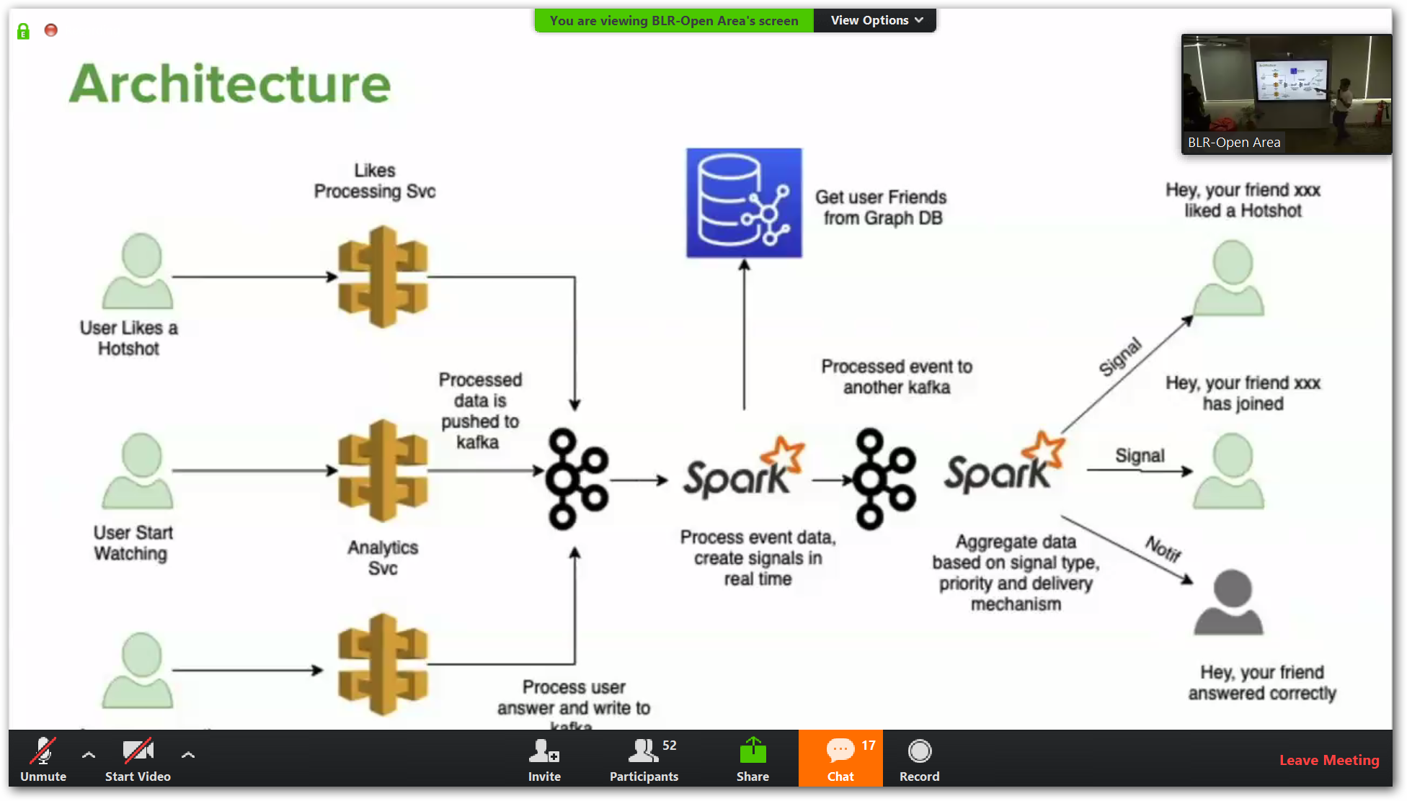
Hotstar

Slide 5
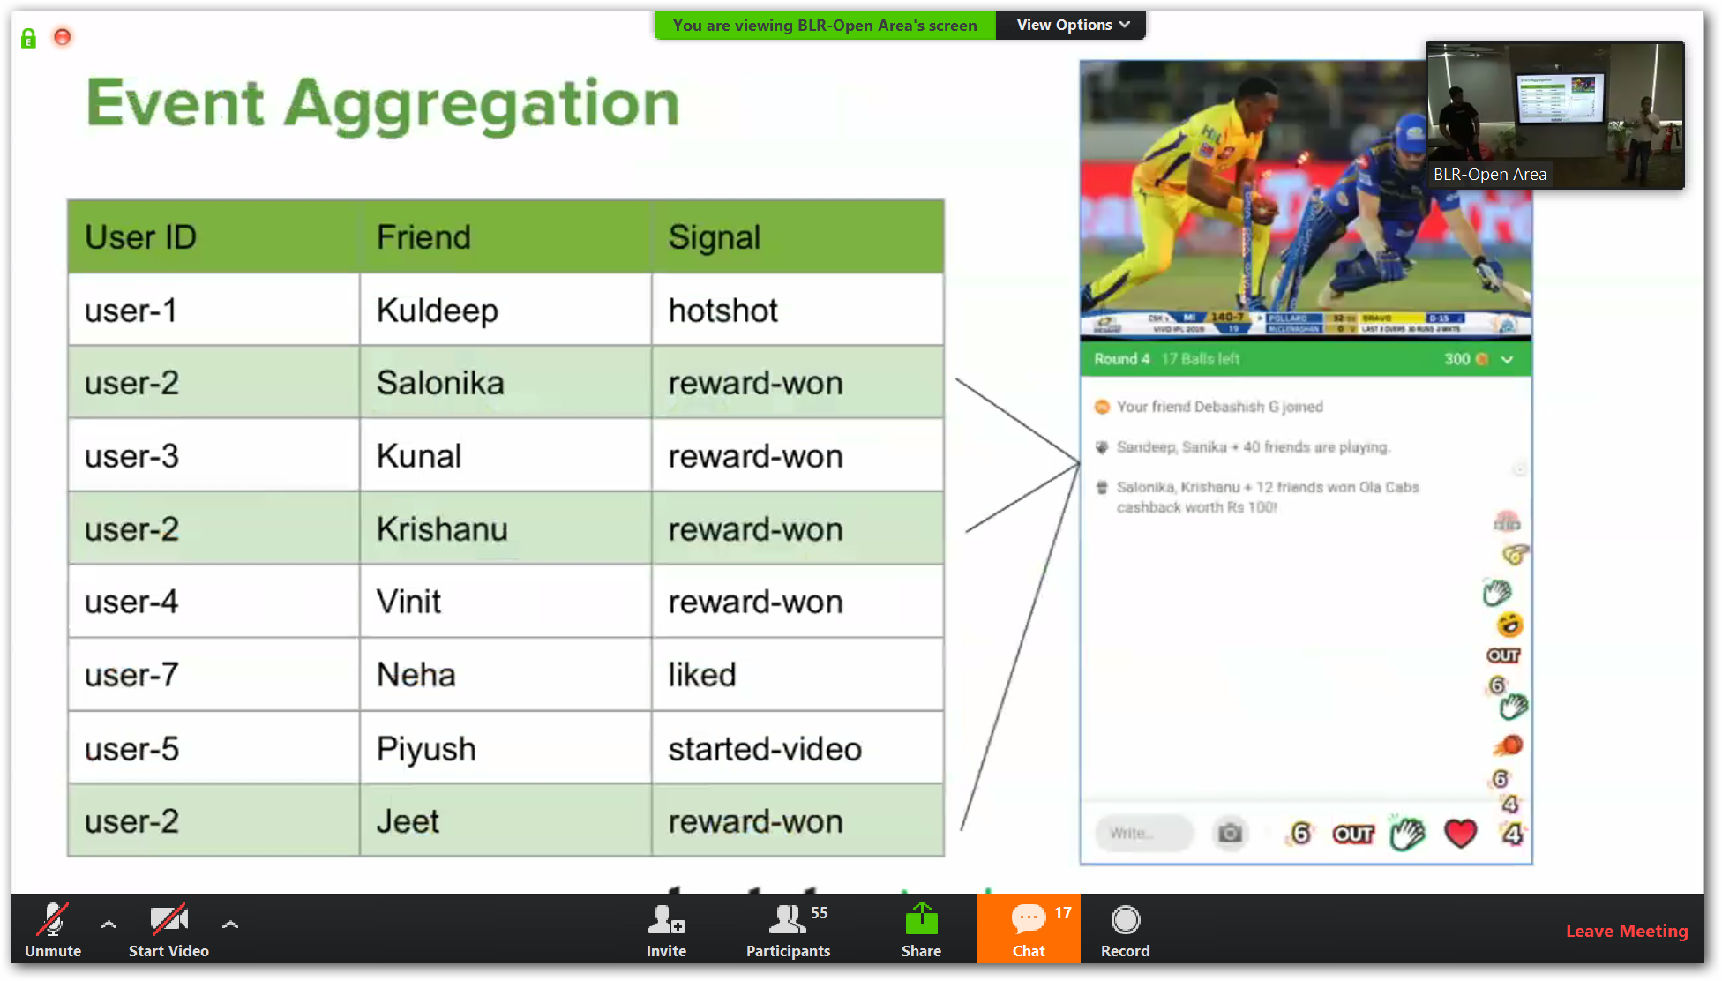

Slide 6
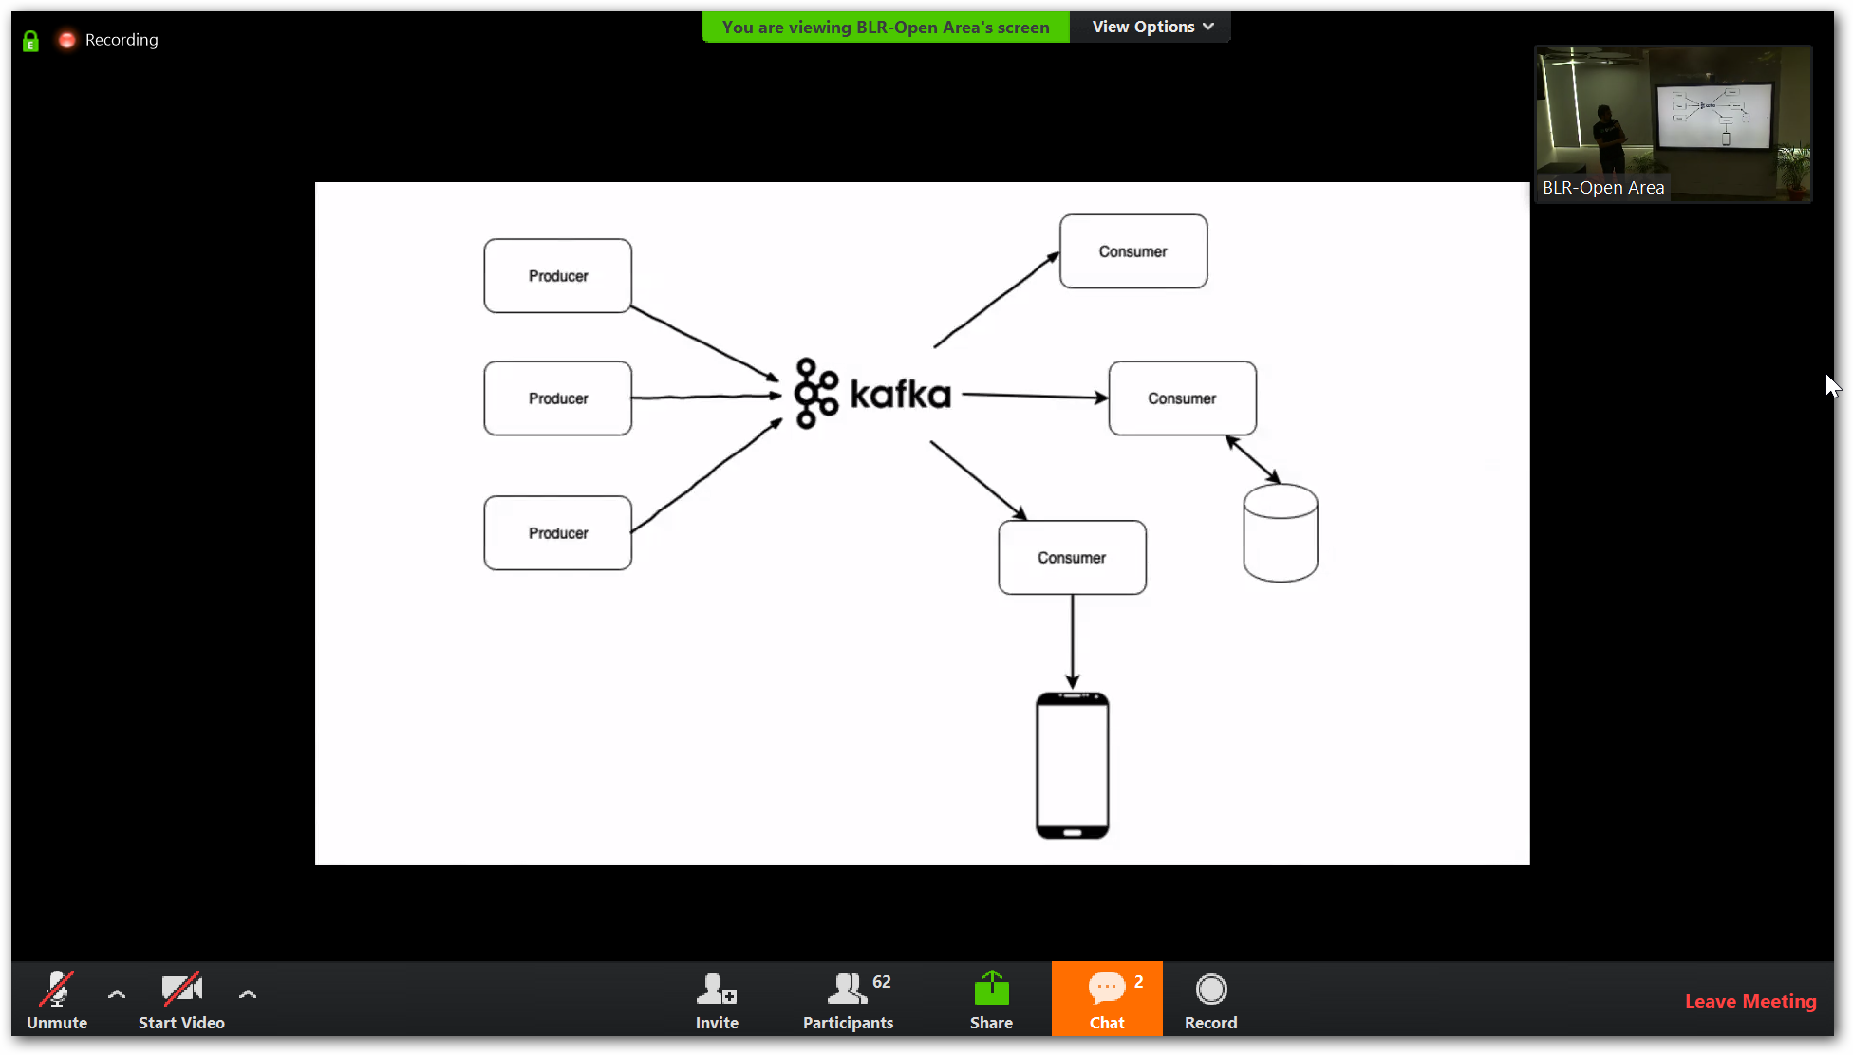
Apache Kafka
Kafka is a little different from your average messaging technology.

Slide 7
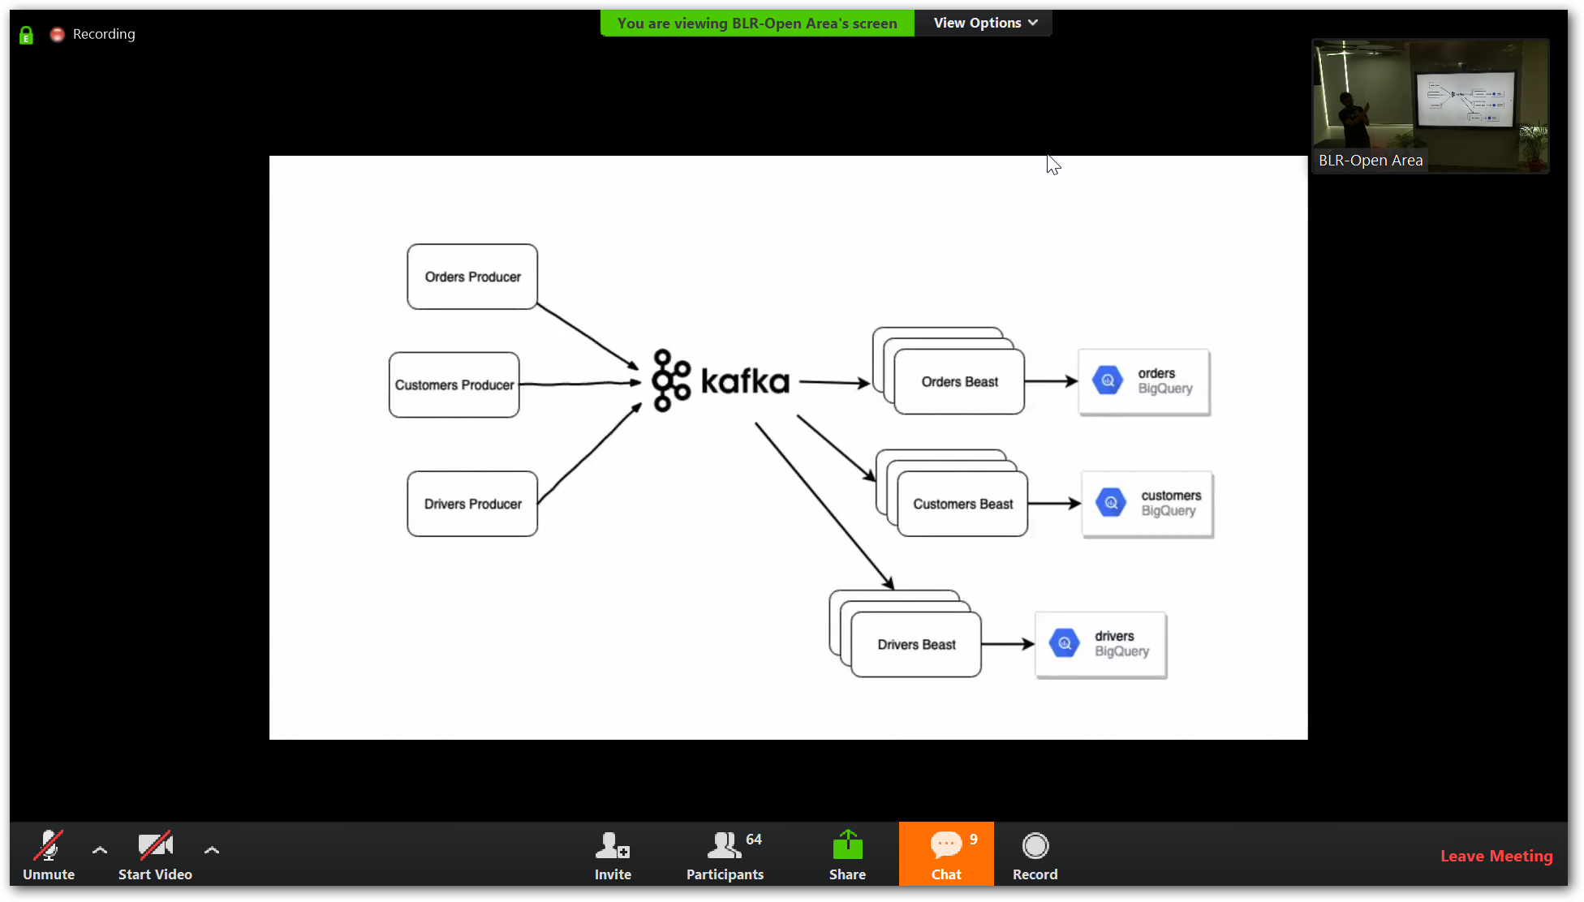

Slide 8
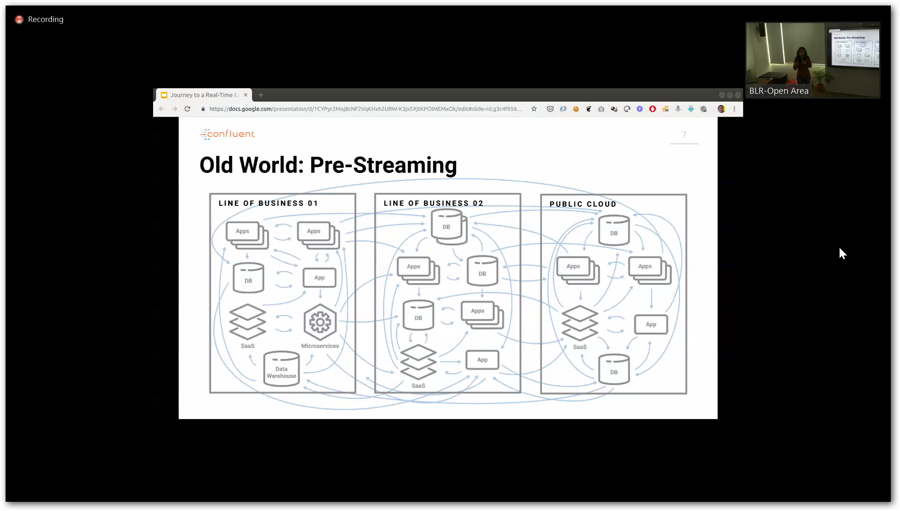

Slide 9
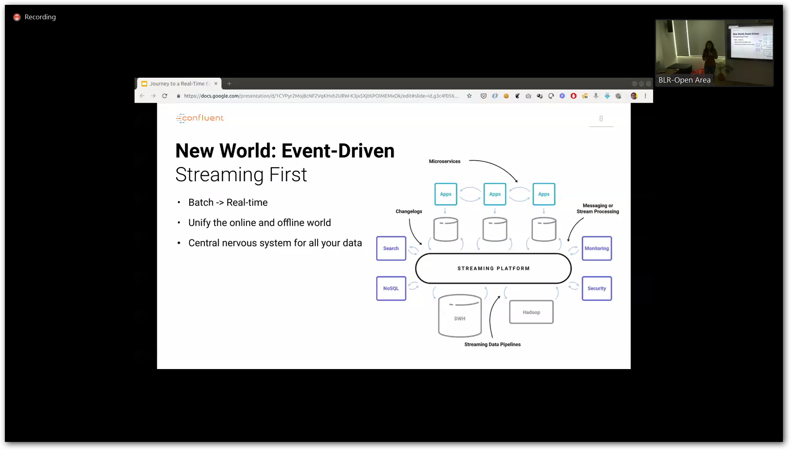

Slide 10
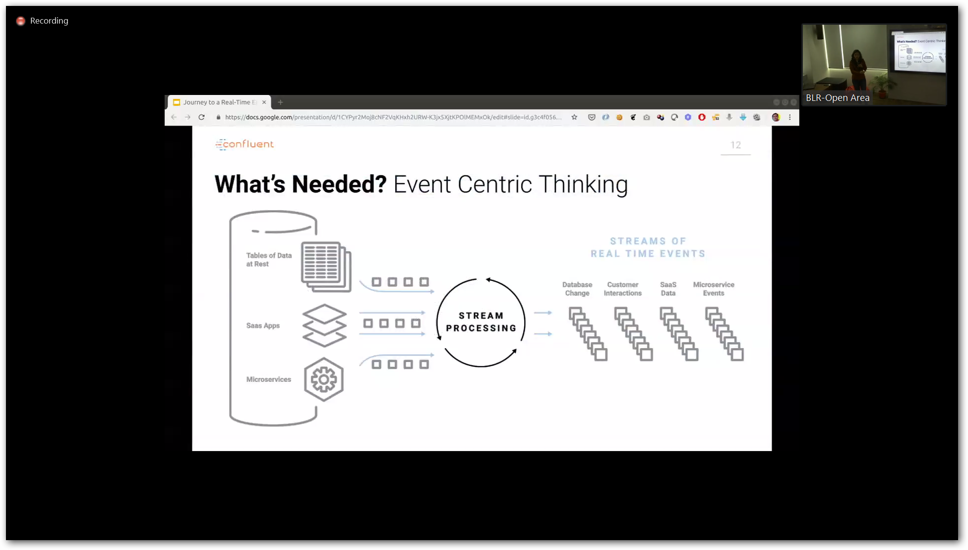

Slide 11
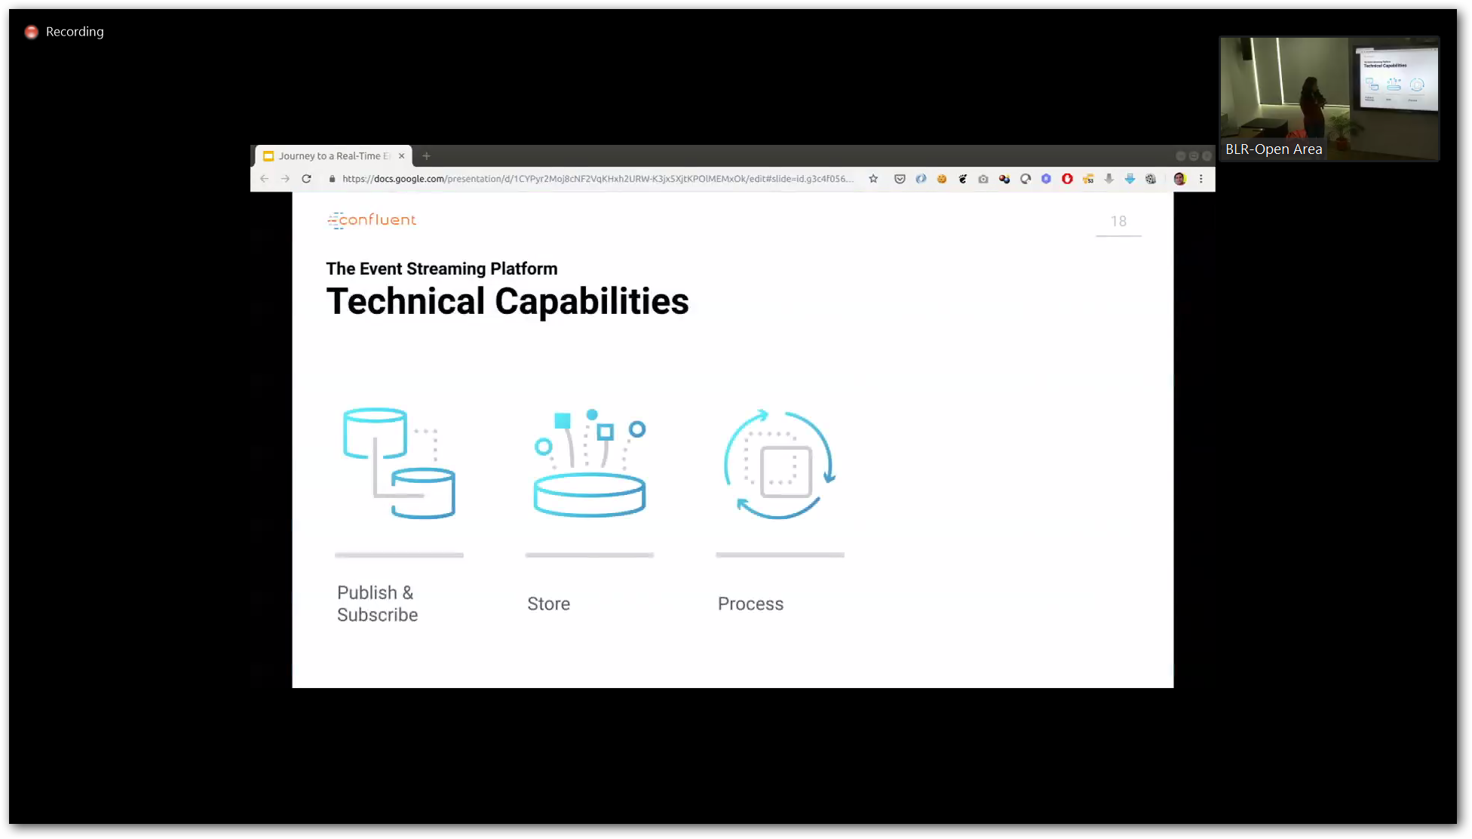

Slide 12
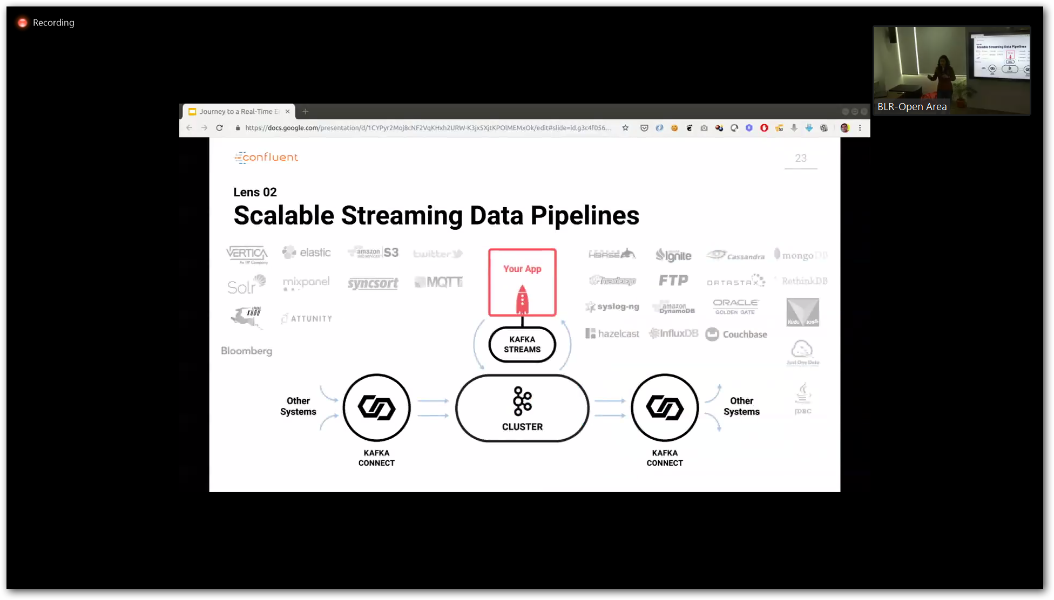
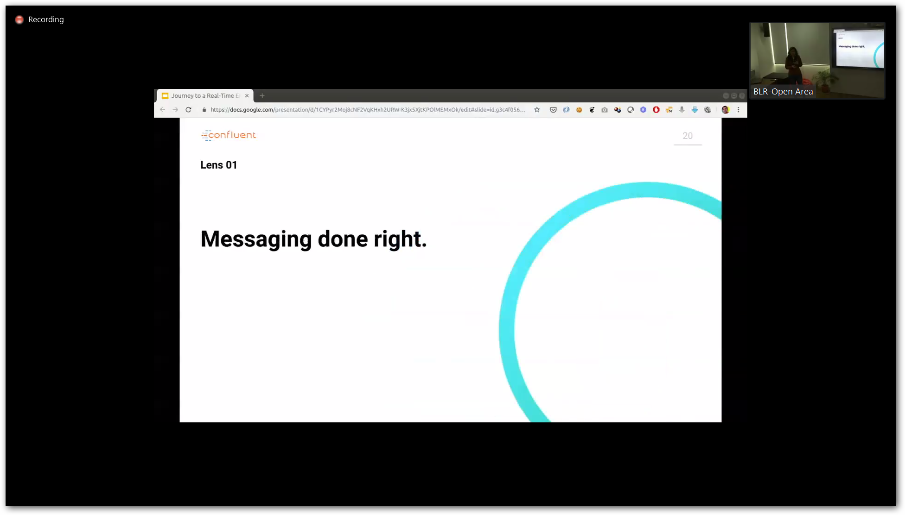
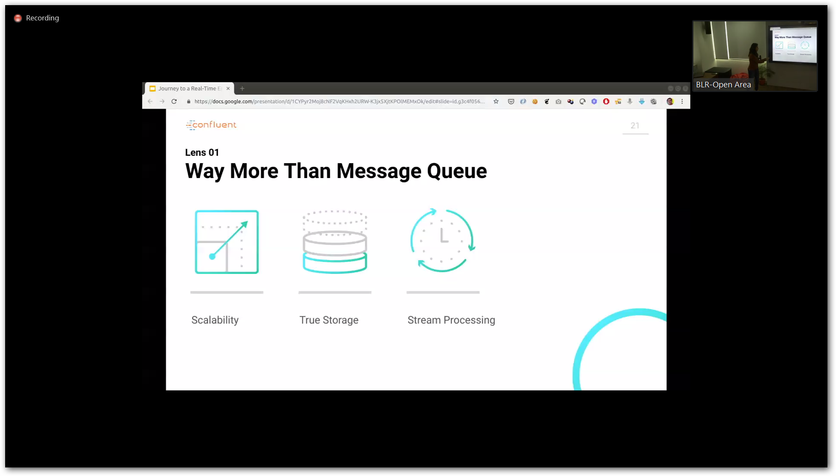

Slide 13
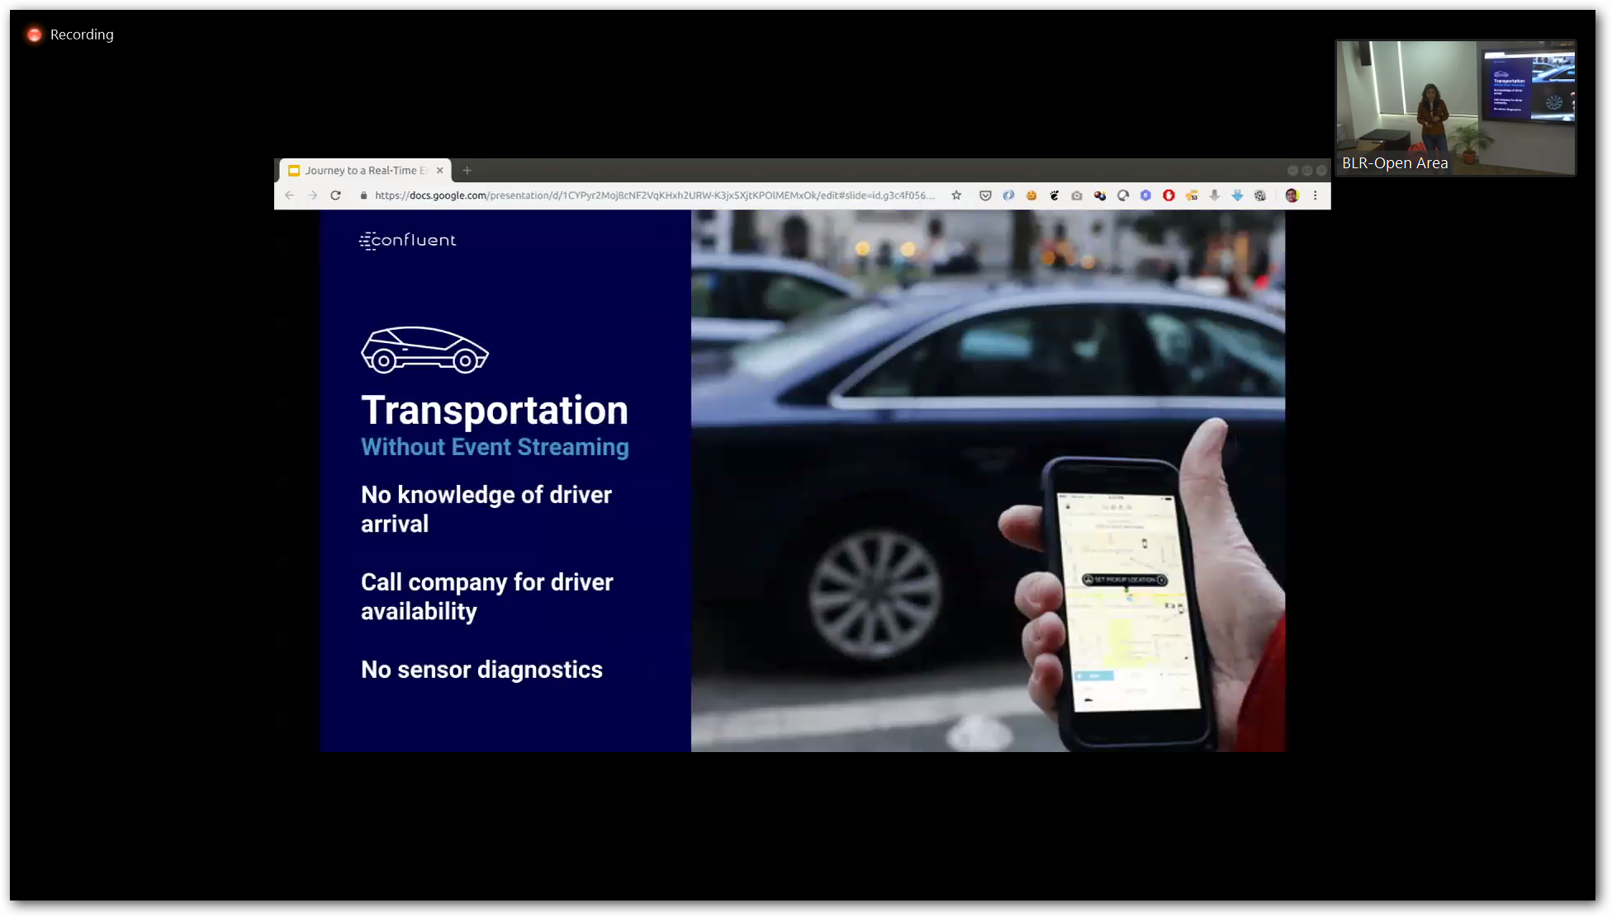

Slide 14
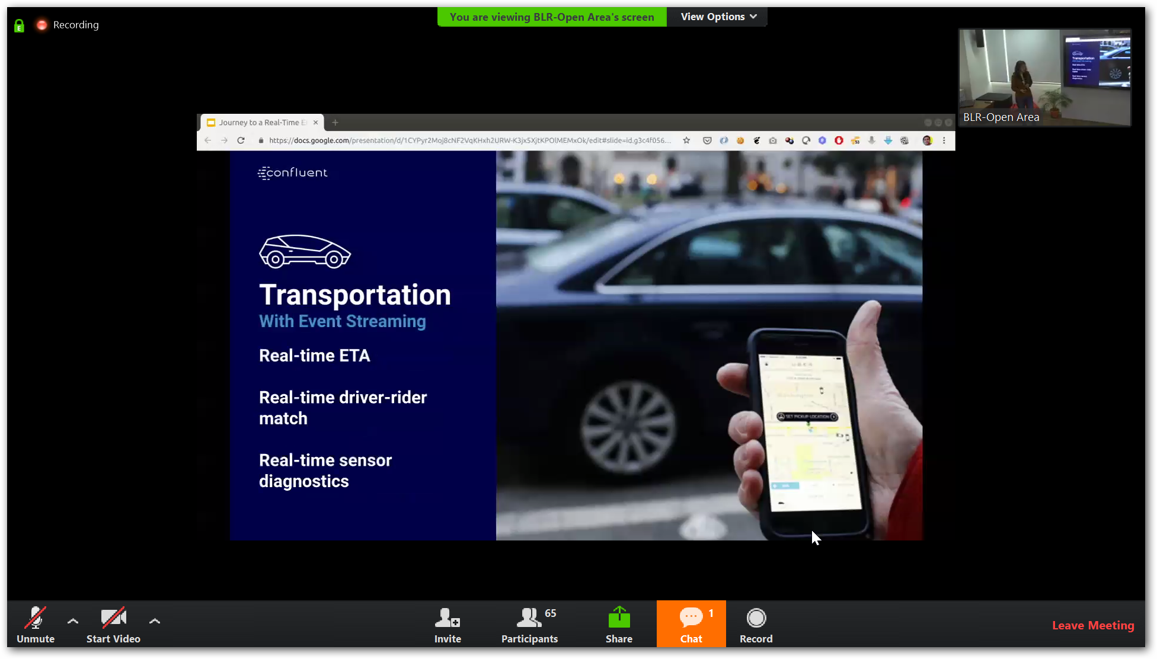

Slide 15
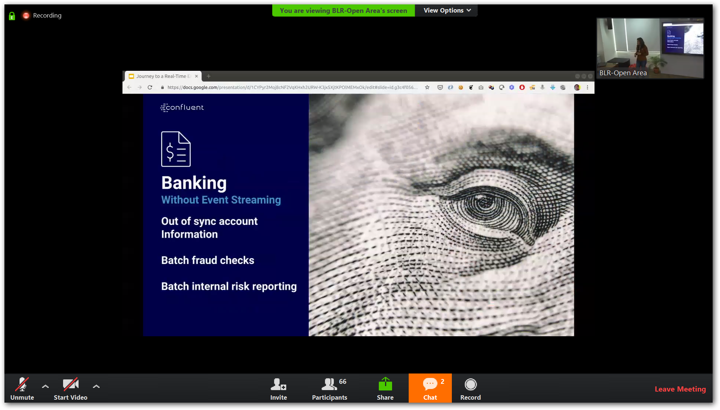

Slide 16
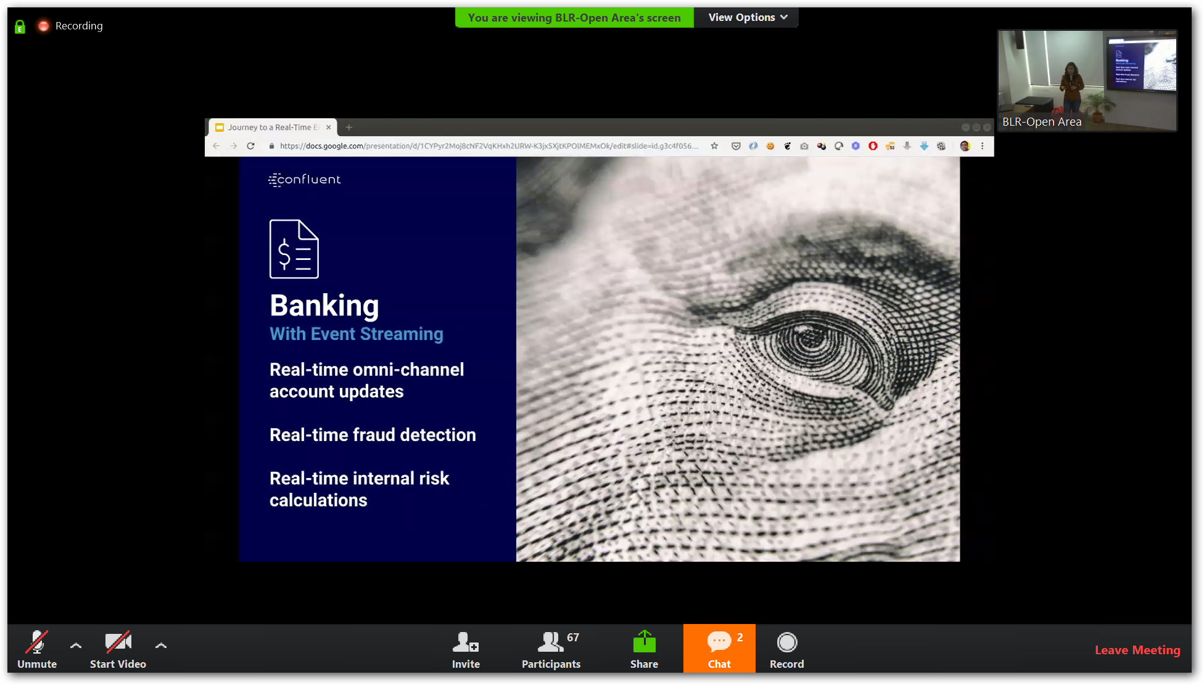

Slide 17
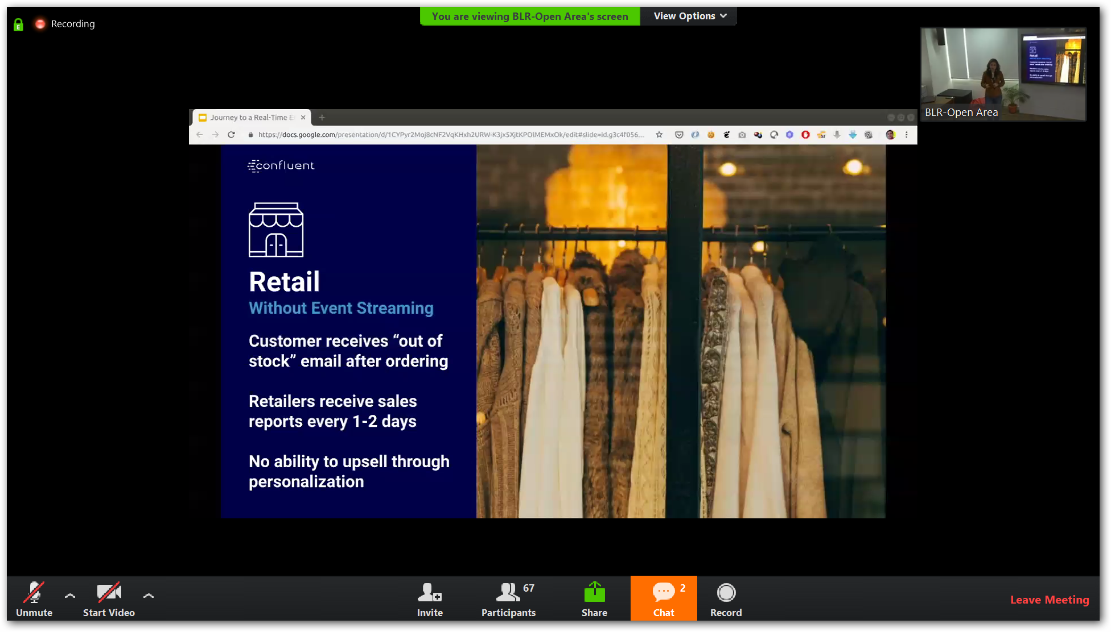

Slide 18
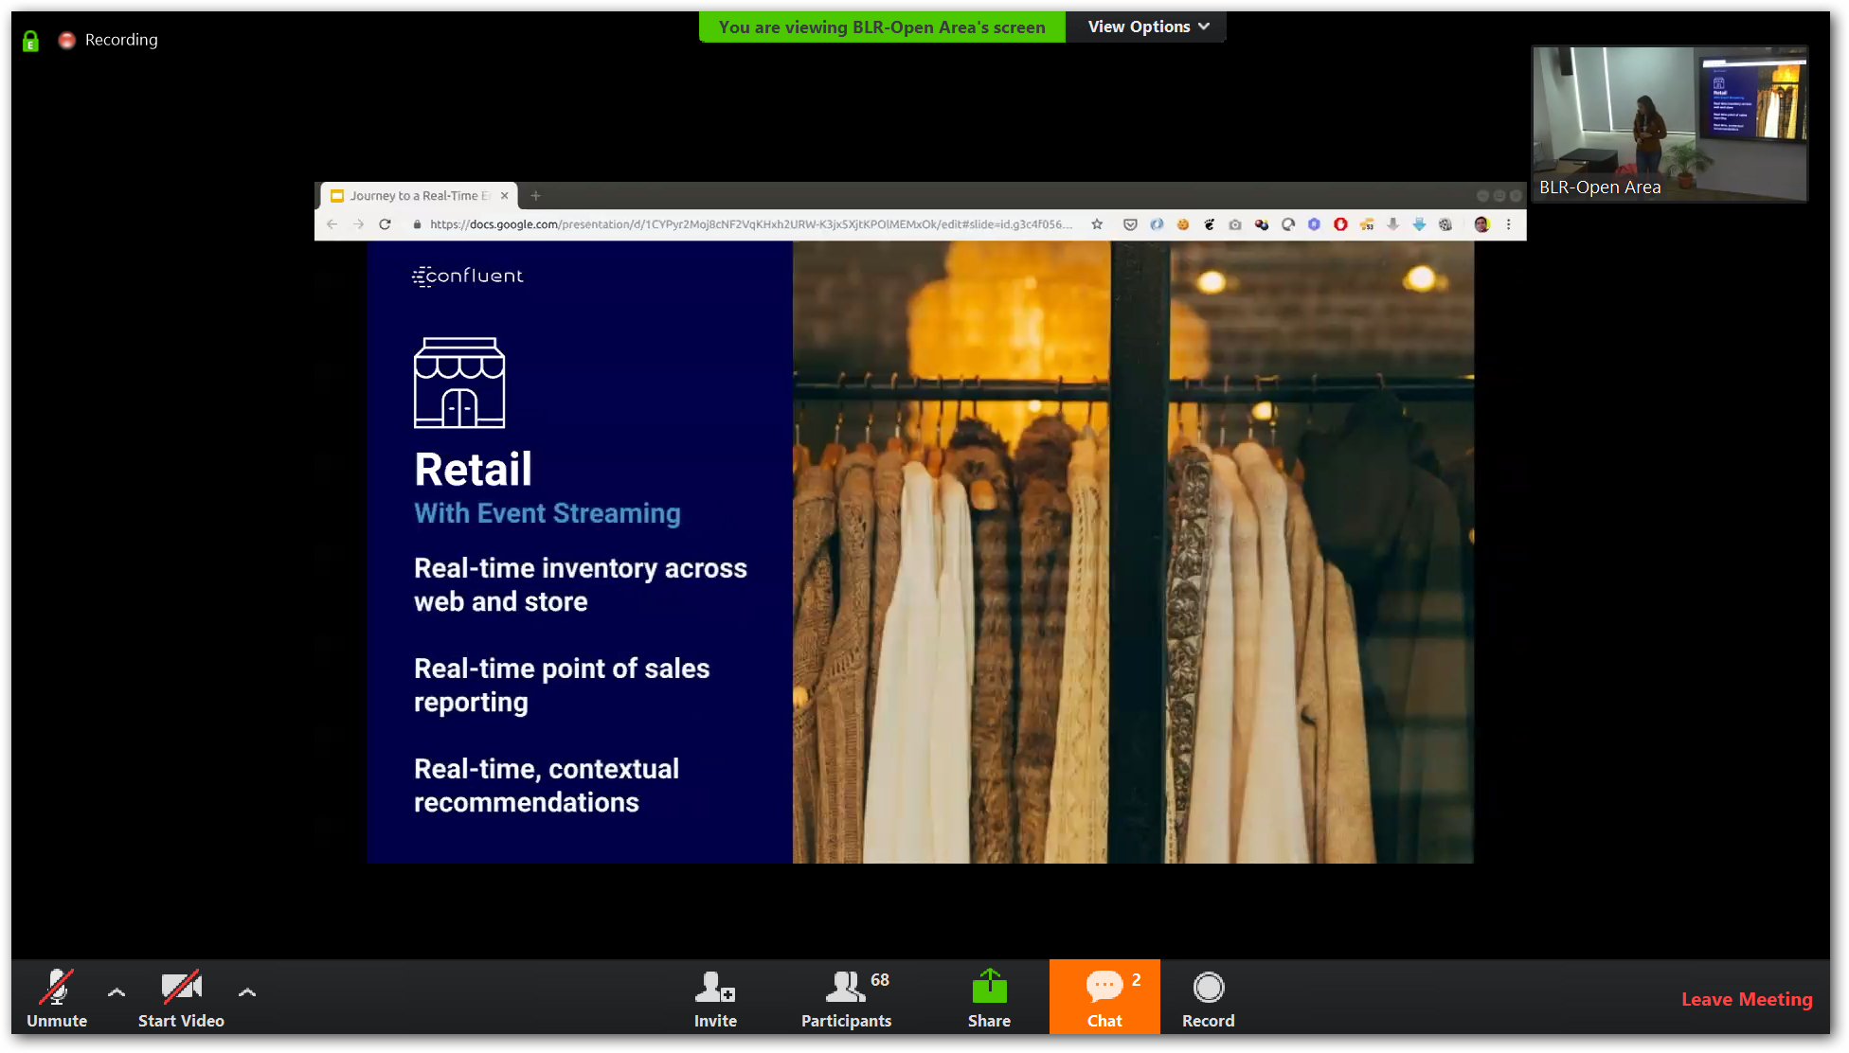

Slide 19
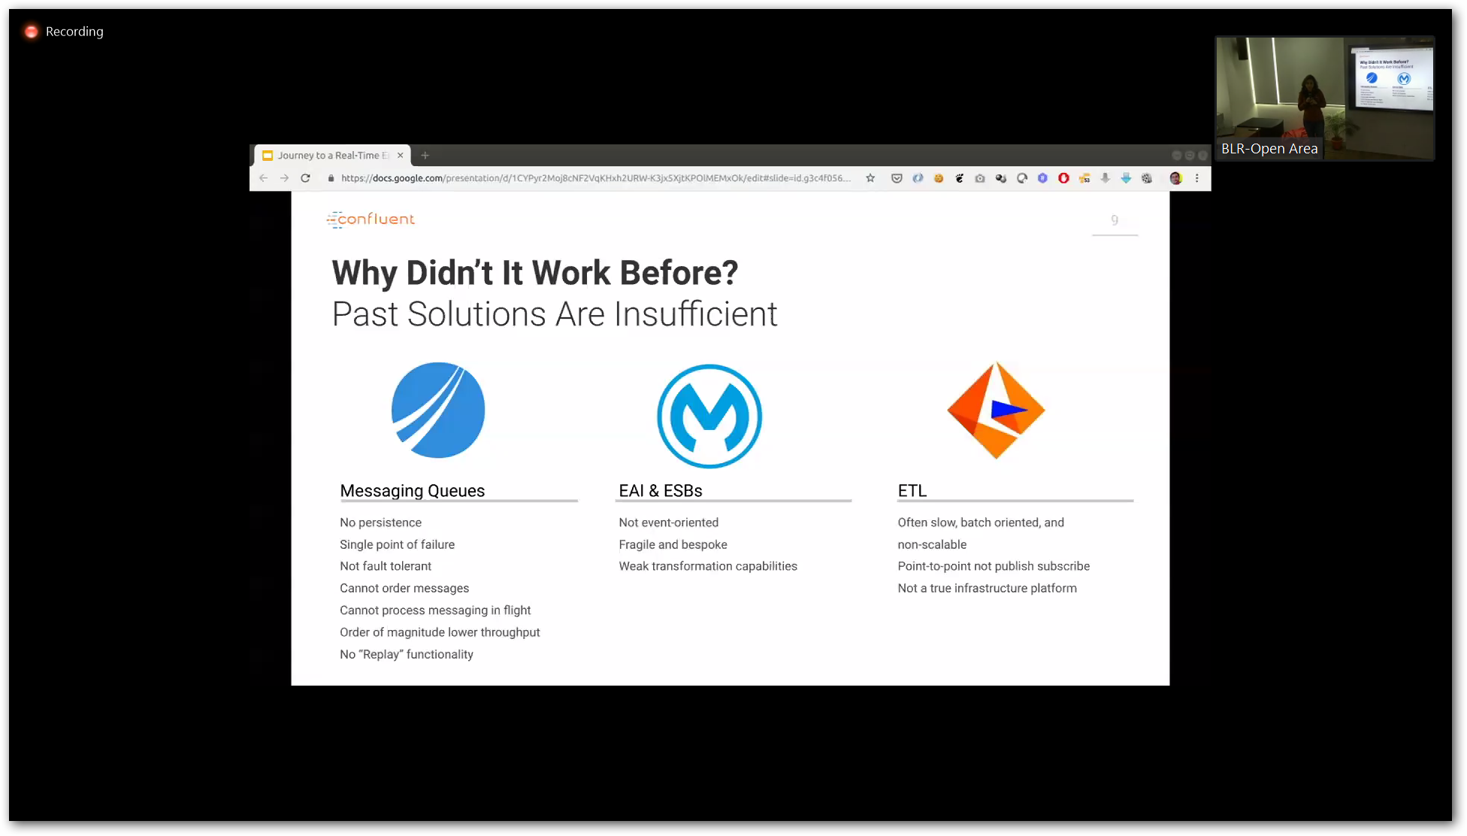

Slide 20
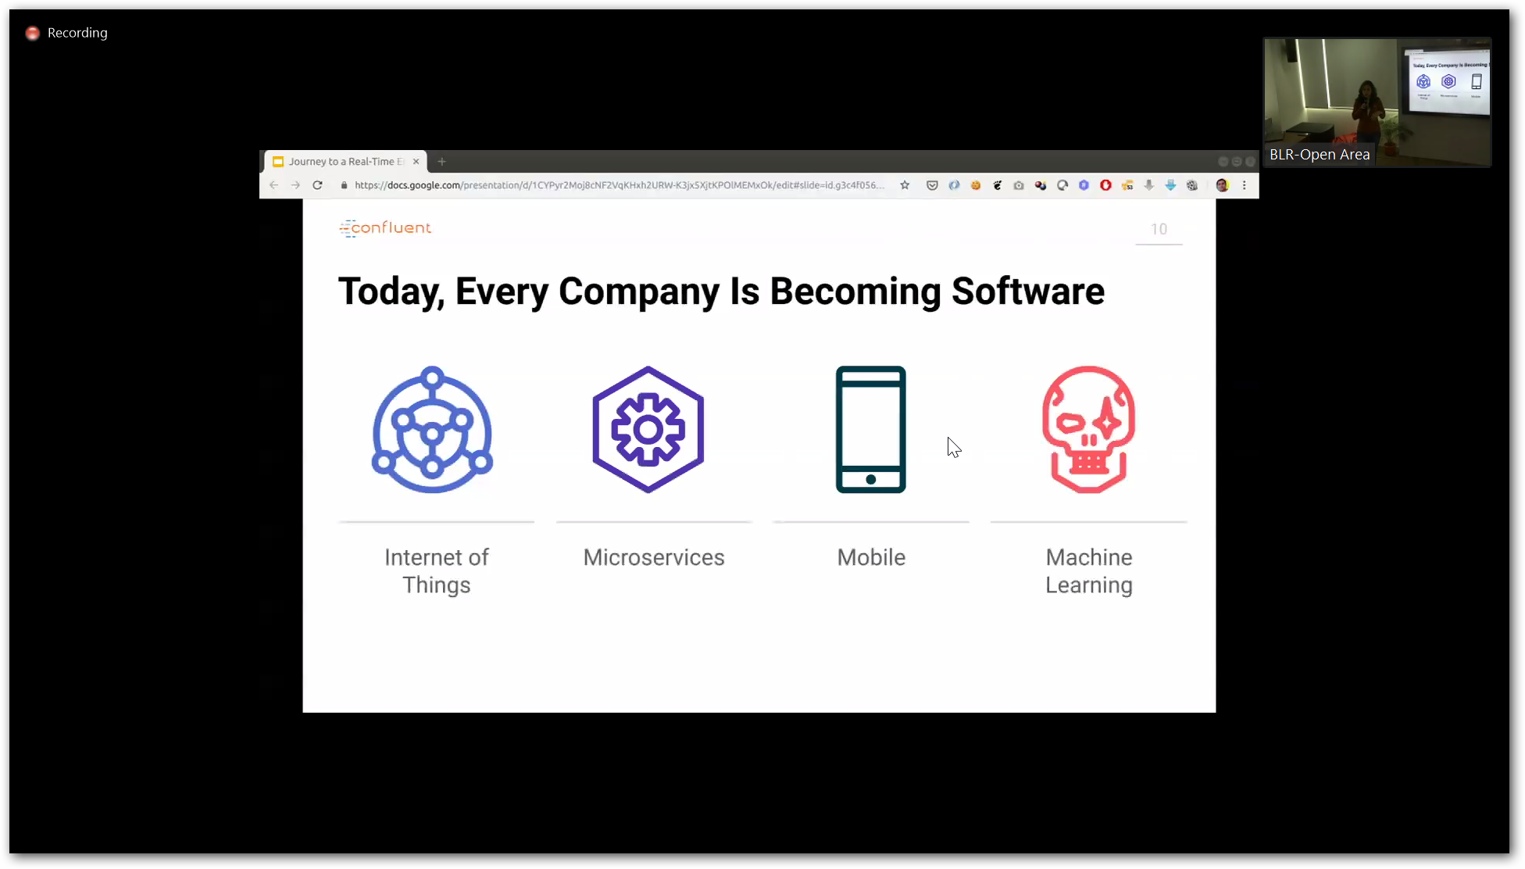

Slide 21
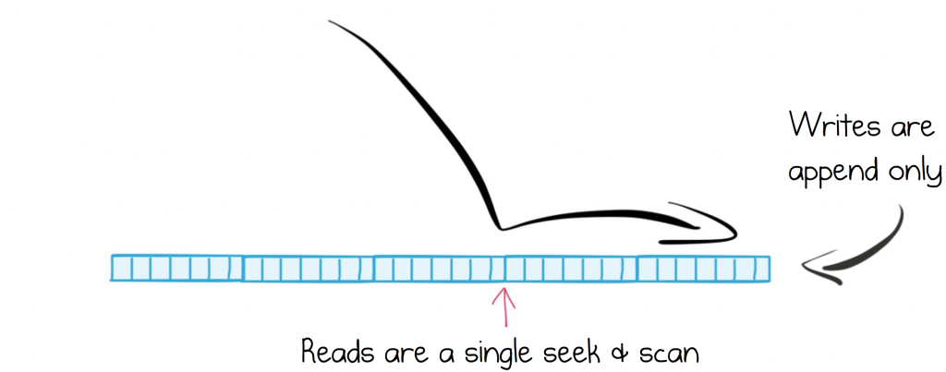
Efficient Structure for Retaining and Distributing Messages

Slide 22
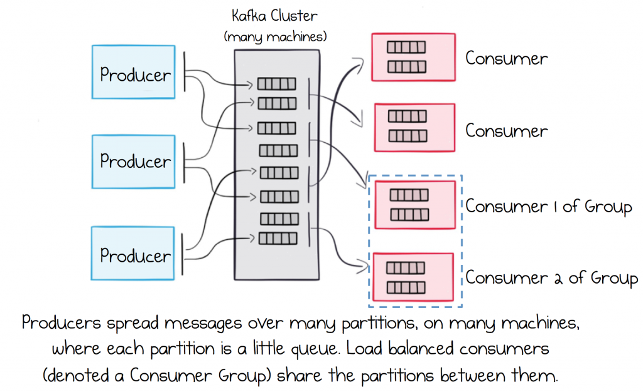
Rely on a Broker that Scales Out Linearly

Slide 23
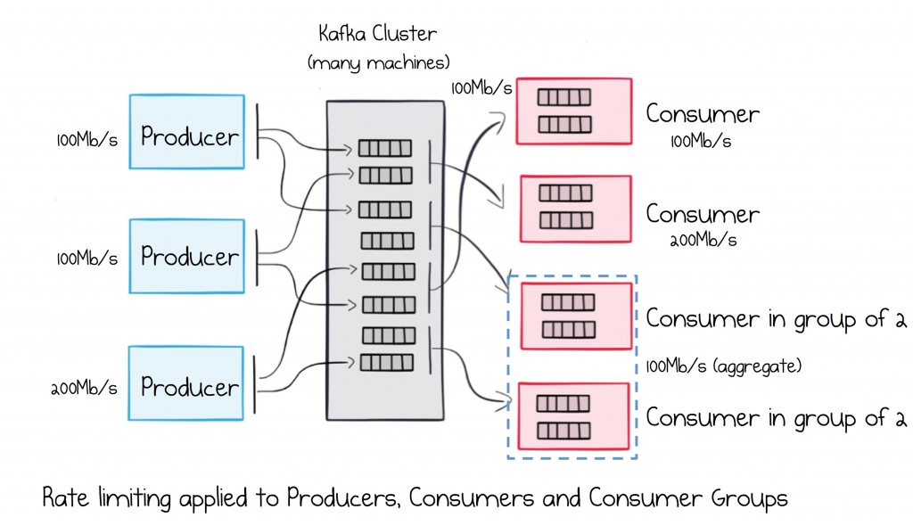
Segregate Load in Multi-Service Ecosystems

Slide 24
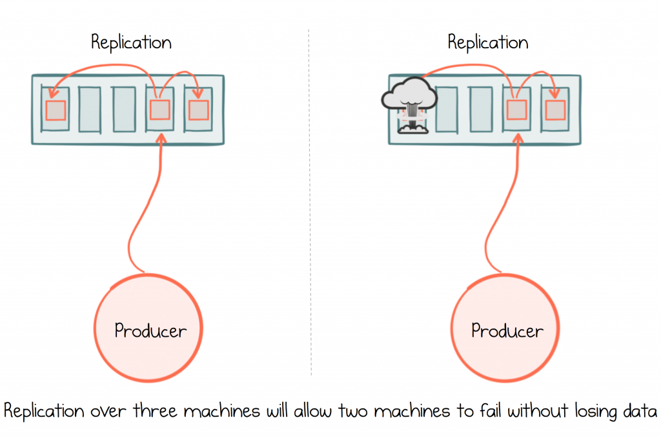
Ensure Messages are Durable

Slide 25
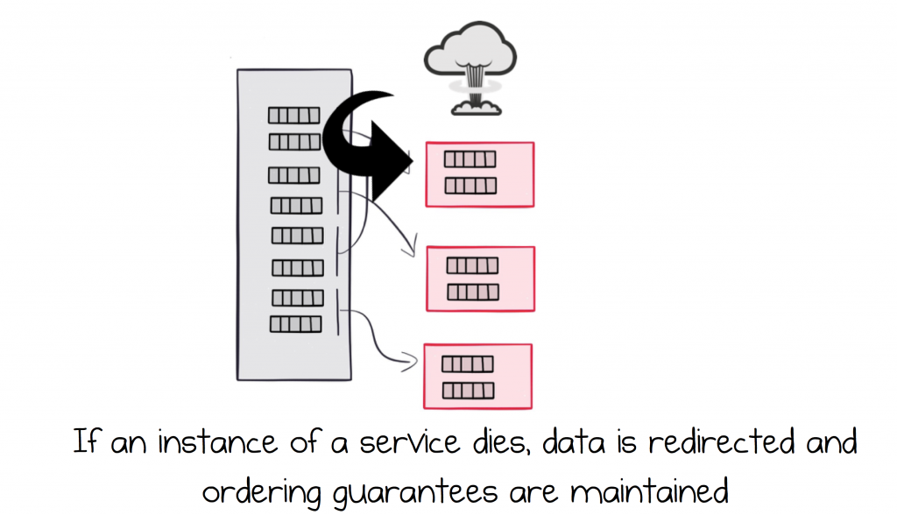
Load Balance Services and make them Highly Available

